Slide 1
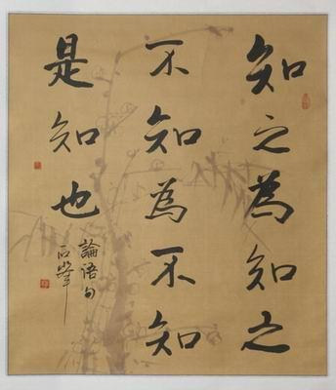
Anomaly Detection
Hung-yi Lee
李宏毅
Source of image: https://zhidao.baidu.com/question/757382451569322644.html
Notes:
為政:
子曰：「由！誨女知之乎？知之為知之，不知為不知，是知也。」為政:
孔子說：「子路啊，我告訴你，知道嗎？知道的就是知道的，不知道的就是不知道的，這就關於知道的真諦。」
AUC
Polutted
Using GAN to generative the negative examples
Pokemon ???
========
Trying to find task :
https://medium.com/alex-attia-blog/the-simpsons-character-recognition-using-keras-d8e1796eae36
(simple is easy)
https://medium.com/@tyreeostevenson/teaching-a-computer-to-classify-anime-8c77bc89b881
https://github.com/mitmul/chainer-handson/blob/master/animeface-character/classify_characters.ipynb
Pokemeon v.s. difimont
========================
Tool:
https://github.com/yzhao062/anomaly-detection-resources
https://scikit-learn.org/stable/modules/outlier_detection.html
========================
There is an overview paper open-set detector
=====================
https://www.youtube.com/watch?v=12Xq9OLdQwQ (learn some theory here)
https://www.youtube.com/watch?v=5vrY4RbeWkM (too simple)
http://cucis.ece.northwestern.edu/projects/DMS/publications/AnomalyDetection.pdf (old 2009)
Overview: https://murphymind.blogspot.com/2017/07/anomaly.detection.html
NG
‘s course: https://www.youtube.com/watch?v=086OcT-5DYI
https://www.quora.com/Do-generative-adversarial-networks-function-for-outlier-detection
https://disp.cc/b/163-b9My
以後看到奇怪的事，就要到派出所報案喔

Slide 2
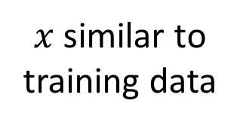
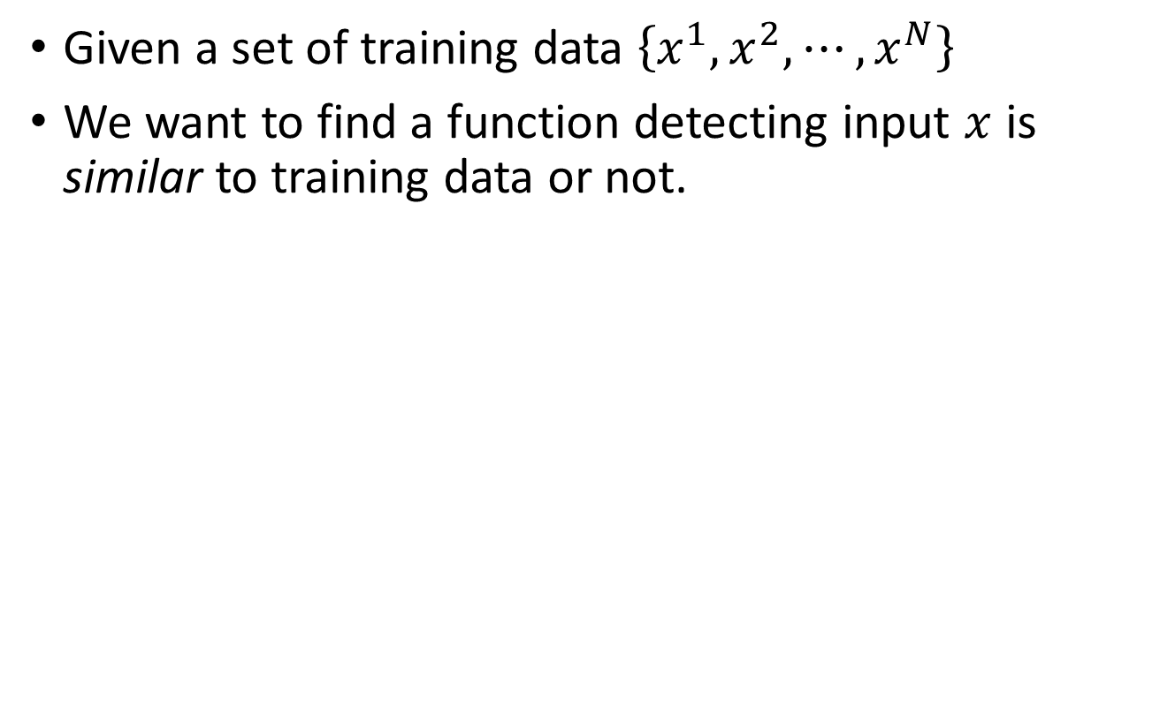
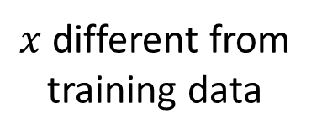
Problem Formulation
Given a set of training data $\left\{x^{1},x^{2},⋯,x^{N}\right\}$
We want to find a function detecting input $x$ is similar to training data or not.
$x$ similar to training data
Anomaly
Detector
normal
outlier, novelty, exceptions
$x$ different from training data
Anomaly
Detector
anomaly
Different approaches use different ways to determine the similarity.

Slide 3






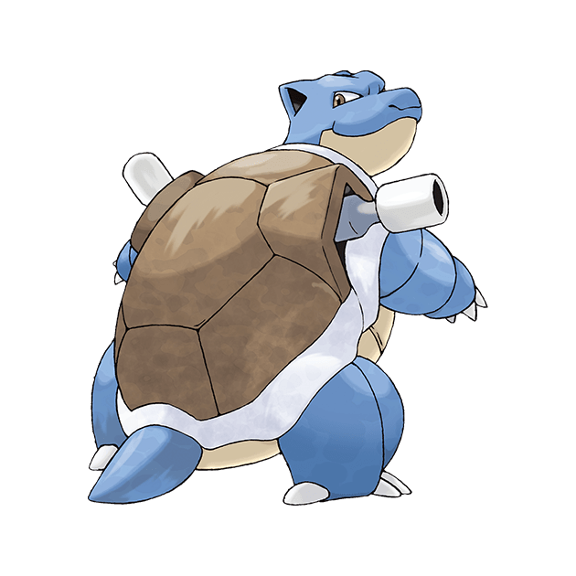

What is Anomaly?
Training Data:
anomaly
Training Data:
anomaly
Training Data:
數碼寶貝
寶可夢
(神奇寶貝)
anomaly

Slide 4
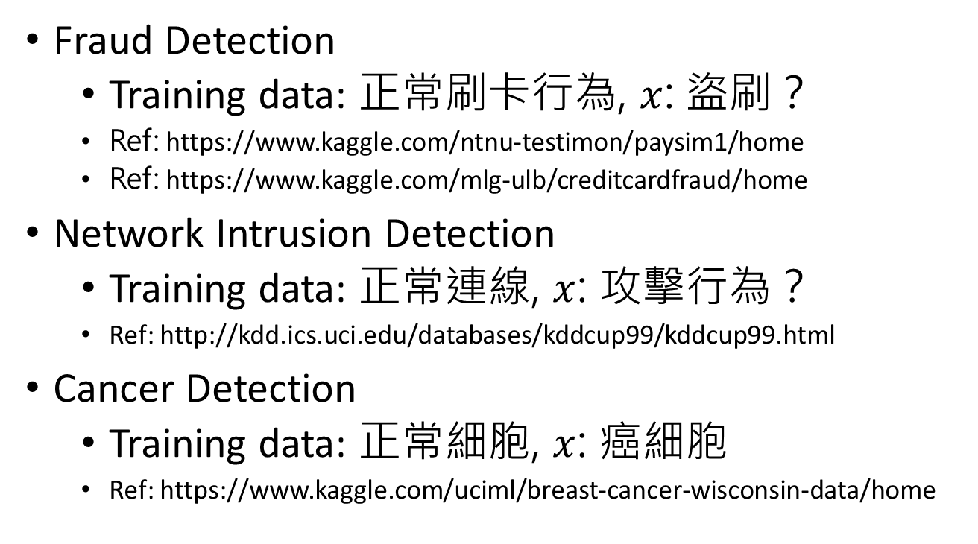
Applications
Fraud Detection
Training data: 正常刷卡行為, $x$: 盜刷？
Ref: https://www.kaggle.com/ntnu-testimon/paysim1/home
Ref: https://www.kaggle.com/mlg-ulb/creditcardfraud/home
Network Intrusion Detection
Training data: 正常連線, $x$: 攻擊行為？
Ref: http://kdd.ics.uci.edu/databases/kddcup99/kddcup99.html
Cancer Detection
Training data: 正常細胞, $x$: 癌細胞
Ref: https://www.kaggle.com/uciml/breast-cancer-wisconsin-data/home
Notes:
https://zhuanlan.zhihu.com/p/42267652
Time series data
https://github.com/numenta/NAB
Lots of data set?
http://odds.cs.stonybrook.edu/

Slide 5
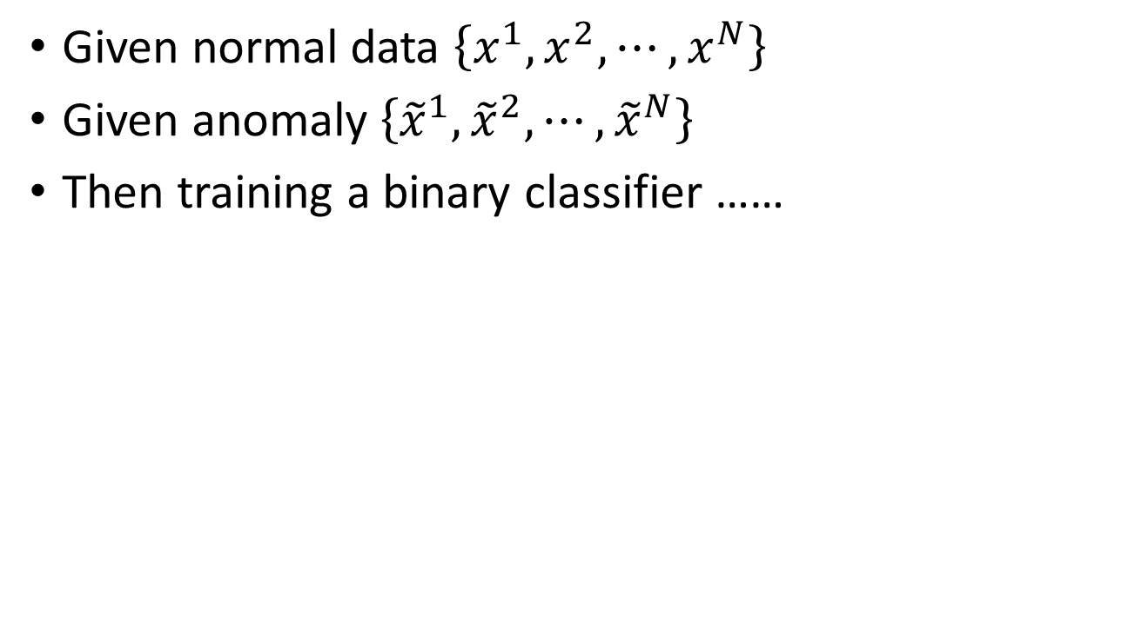
Binary Classification?
Given normal data $\left\{x^{1},x^{2},⋯,x^{N}\right\}$
Given anomaly $\left\{{\tilde{x}}^{1},{\tilde{x}}^{2},⋯,{\tilde{x}}^{N}\right\}$
Then training a binary classifier ……
Class 1
Class 2

Slide 6
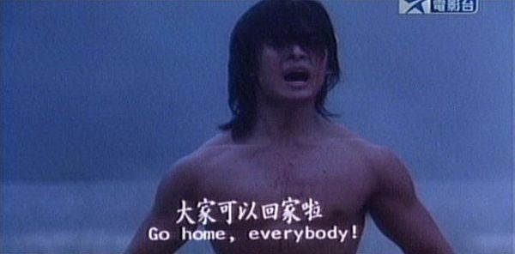
Binary Classification?
Given normal data $\left\{x^{1},x^{2},⋯,x^{N}\right\}$
Given anomaly $\left\{{\tilde{x}}^{1},{\tilde{x}}^{2},⋯,{\tilde{x}}^{N}\right\}$
Then training a binary classifier ……
Class 1
Class 2

Slide 7
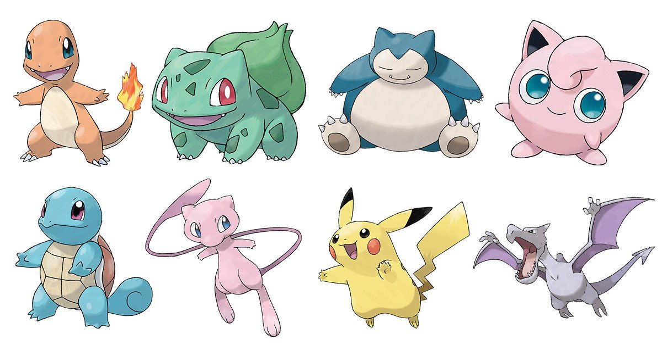

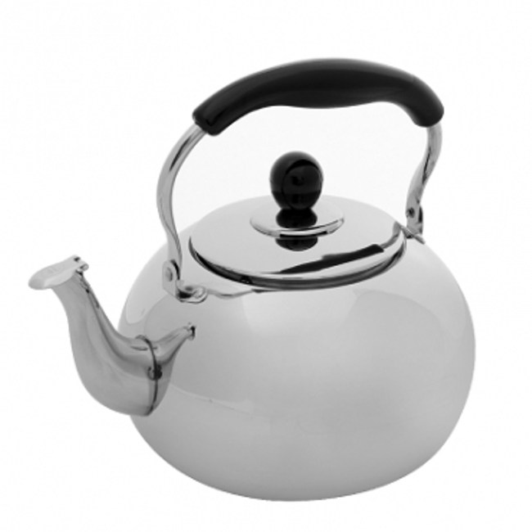
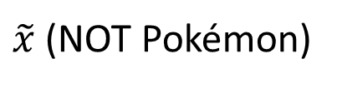
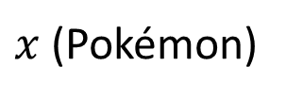
Binary Classification?
Given normal data $\left\{x^{1},x^{2},⋯,x^{N}\right\}$
Given anomaly $\left\{{\tilde{x}}^{1},{\tilde{x}}^{2},⋯,{\tilde{x}}^{N}\right\}$
Then training a binary classifier ……
Class 1
Class 2
$x$ (Pokémon)
$\tilde{x}$ (NOT Pokémon)
cannot be considered as a class
Even worse, in some cases, it is difficult to find anomaly example ……

Slide 8
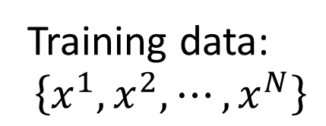
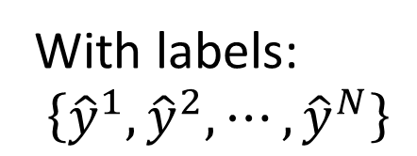
Categories
With labels:
$$\left\{{\hat{y}}^{1},{\hat{y}}^{2},⋯,{\hat{y}}^{N}\right\}$$
Classifier
The classifier can output “unknown” (none of the training data is labelled “unknown” )
Training data:
$$\left\{x^{1},x^{2},⋯,x^{N}\right\}$$
Open-set Recognition
Clean: All the training data is normal.
Polluted: A little bit of training data is anomaly.
Notes:
Polluted is freq!

Slide 9
Case 1: With Classifier
Notes:
I ignore ODIN and Ensemble here ……
Should I add them????????

Slide 10




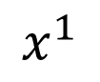
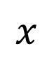
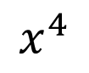
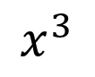
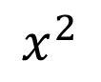
Example Application
$$x$$
From The Simpsons or not
$$x^{1}$$
$$x^{2}$$
$$x^{3}$$
$$x^{4}$$

Slide 11

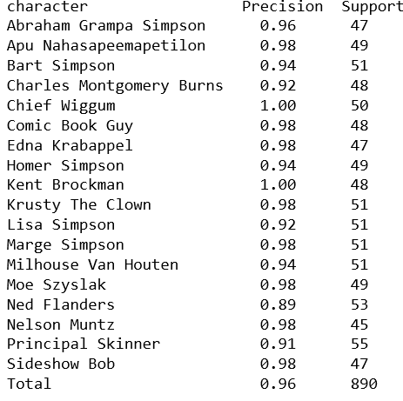
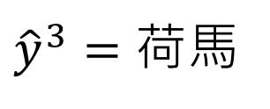
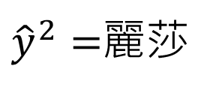
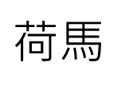
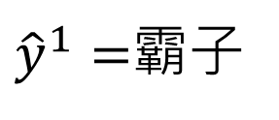
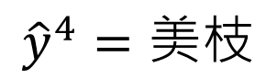
Source of model: https://www.kaggle.com/alexattia/the-simpsons-characters-dataset/
Simpsons Character Classifier
$荷$馬
$$x^{1}$$
$$x^{2}$$
$$x^{3}$$
$$x^{4}$$
${\hat{y}}^{1}=$霸子
${\hat{y}}^{2}=$麗莎
${\hat{y}}^{3}=荷$馬
$${\hat{y}}^{4}=美枝$$
Notes:
https://github.com/alexattia/SimpsonRecognition
https://www.kaggle.com/alexattia/the-simpsons-characters-dataset/kernels

Slide 12
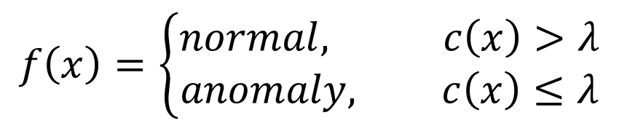
How to use the Classifier
Classifier
Class y
Input
x
Confidence score c
Anomaly Detection:
$$f\left(x\right)=\left\{\begin{aligned}normal, c\left(x\right)>λ \\ &anomaly, c\left(x\right)≤λ\end{aligned}\right.$$

Slide 13


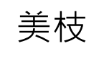
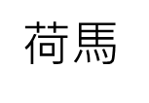
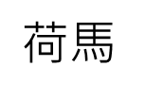
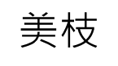
How to estimate Confidence
Simpsons Character Classifier
霸子
0.97
麗莎
0.01
Normal
$荷$馬
0.01
$$美枝$$
0.01
Very Confident
Simpsons Character Classifier
霸子
0.24
麗莎
0.26
Anomaly
$荷$馬
0.25
$$美枝$$
0.25
Not Confident
Confidence: the maximum scores
or negative Entropy
Notes:
Available

Slide 14

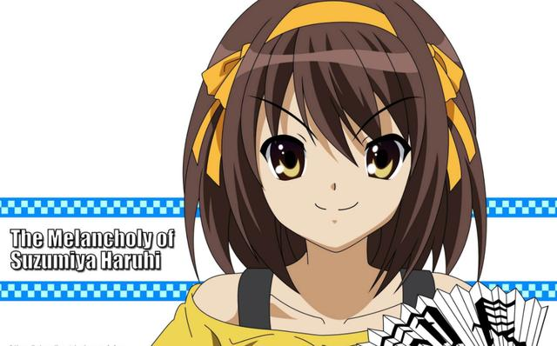

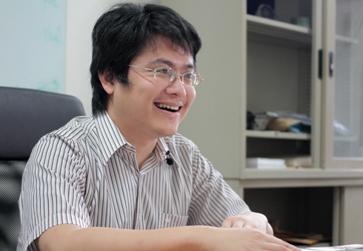
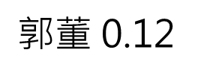
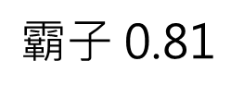
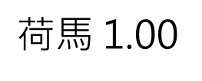
柯阿三 0.34
$荷$馬 1.00
陳趾鹹 0.31
柯阿三 0.99
魯肉王 0.10
$霸子$ 0.81
柯阿三 0.63
宅神 0.08
$郭$董 0.12
小丑阿基 0.04
(辛普森家庭腳色)
孔龍金 0.03
Notes:
map_characters = {0: 'abraham_grampa_simpson', 1: 'apu_nahasapeemapetilon', 2: 'bart_simpson',
3: 'charles_montgomery_burns', 4: 'chief_wiggum', 5: 'comic_book_guy', 6: 'edna_krabappel',
7: 'homer_simpson', 8: 'kent_brockman', 9: 'krusty_the_clown', 10: 'lisa_simpson',
11: 'marge_simpson', 12: 'milhouse_van_houten', 13: 'moe_szyslak',
14: 'ned_flanders', 15: 'nelson_muntz', 16: 'principal_skinner', 17: 'sideshow_bob'}

Slide 15
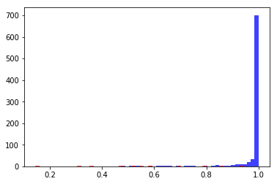
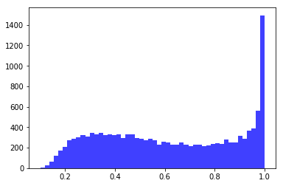
Confidence score distribution for characters from Simpsons
Almost
Confidence score distribution for anime characters
10%

Slide 16
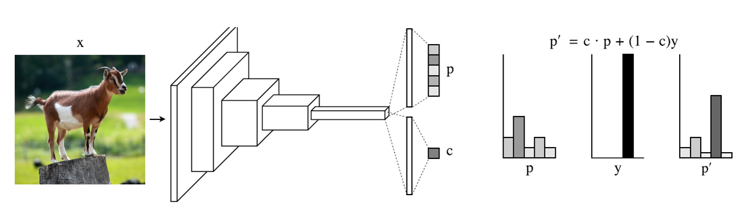
Outlook: Network for Confidence Estimation
Learning a network that can directly output confidence
Terrance DeVries, Graham W. Taylor, Learning Confidence for Out-of-Distribution Detection in Neural Networks, arXiv, 2018
(not today)

Slide 17
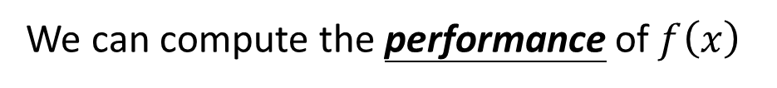
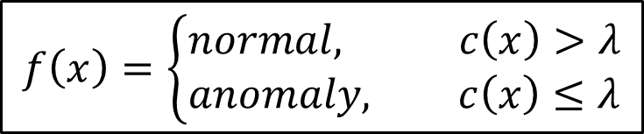
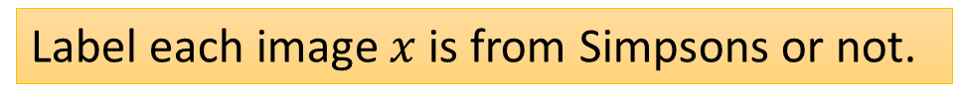
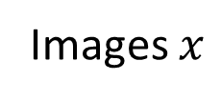
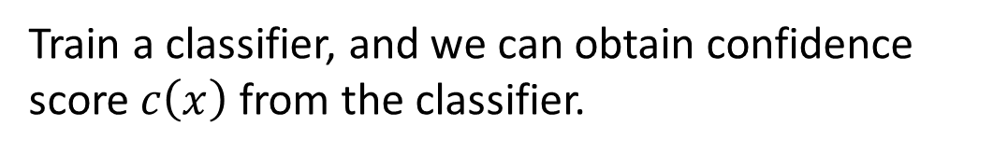
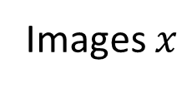
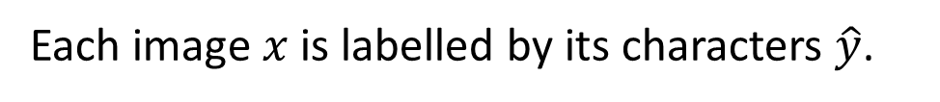
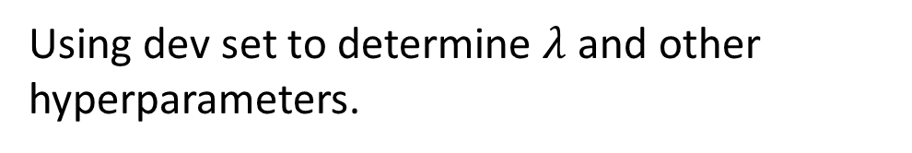
Example Framework
Training Set: Images $x$ of characters from Simpsons.
Each image $x$ is labelled by its characters $\hat{y}$.
Train a classifier, and we can obtain confidence score $c\left(x\right)$ from the classifier.
$$f\left(x\right)=\left\{\begin{aligned}normal, c\left(x\right)>λ \\ &anomaly, c\left(x\right)≤λ\end{aligned}\right.$$
Dev Set:
Images $x$
Label each image $x$ is from Simpsons or not.
We can compute the performance of $f\left(x\right)$
Using dev set to determine $λ$ and other hyperparameters.
Testing Set:
Images $x$
from Simpsons or not

Slide 18
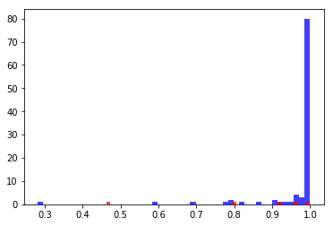






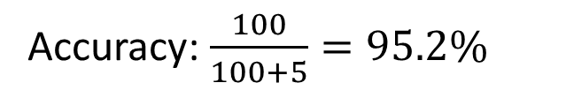
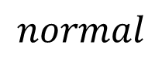
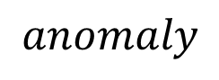

Evaluation
Accuracy is not a good measurement!
A system can have high accuracy, but do nothing.
100 Simpsons, 5 anomalies
Most
> 0.998
5 wrong, 100 correct
Accuracy: $\frac{100}{100+5}=95.2\%$
0.998
$$anomaly$$
$$normal$$
$$λ$$

Slide 19



 | Anomaly | Normal
Detected | 1 | 1
Not Det | 4 | 99
False alarm
missing
100 Simpsons, 5 anomalies
$$anomaly$$
$$normal$$
$$λ$$

Slide 20



 | Anomaly | Normal
Detected | 1 | 1
Not Det | 4 | 99
 | Anomaly | Normal
Detected | 2 | 6
Not Det | 3 | 94
100 Simpsons, 5 anomalies
$$anomaly$$
$$normal$$
$$λ$$

Slide 21

 | Anomaly | Normal
Detected | 1 | 1
Not Det | 4 | 99
 | Anomaly | Normal
Detected | 2 | 6
Not Det | 3 | 94
Cost = 104
Cost = 603
Cost = 401
Cost = 306
Cost | Anomaly | Normal
Detected | 0 | 100
Not Det | 1 | 0
Cost | Anomaly | Normal
Detected | 0 | 1
Not Det | 100 | 0
Cost Table A
Cost Table B
Some evaluation metrics consider the ranking
For example, Area under ROC curve
Notes:
Case B: cancer detect

Slide 22










Possible Issues ……

Slide 23



Possible Issues ……
柯阿三 0.34
宅神 0.82
麗莎 1.00
柯阿三 0.63
麗莎 0.88

Slide 24

To Learn More ……
Learn a classifier giving low confidence score to anomaly
How can you obtain anomaly?
Kimin Lee, Honglak Lee, Kibok Lee, Jinwoo Shin, Training Confidence-calibrated Classifiers for Detecting Out-of-Distribution Samples, ICLR 2018
Generating by Generative Models?
Mark Kliger, Shachar Fleishman, Novelty Detection with GAN, arXiv, 2018
Notes:
Using GAN to generative the negative examples

Slide 25
Case 2: Without Labels
Notes:
Assumption: most of them are normal player
https://www.reddit.com/r/twitchplayspokemon/comments/49ki48/top_ten_tpp_trolls_of_all_time/
https://jgeekstudies.org/2016/10/08/the-effect-of-trolls-on-twitch-plays-pokemon/
https://www.wired.com/2014/02/twitch-plays-pokemon/
https://kotaku.com/how-people-are-actually-making-progress-in-twitch-play-1525261786
https://kotaku.com/not-everyone-playing-twitch-plays-pokemon-appears-to-1530921548
https://www.quora.com/Do-all-the-trolls-on-Twitch-Plays-Pokemon-make-it-funnier
========
Do I have to mention the native approach like clustering or KNN??????
====================
There is an overview paper open-set detector
=====================
https://www.youtube.com/watch?v=12Xq9OLdQwQ (learn some theory here)
https://www.youtube.com/watch?v=5vrY4RbeWkM (too simple)
http://cucis.ece.northwestern.edu/projects/DMS/publications/AnomalyDetection.pdf (old 2009)
Overview: https://murphymind.blogspot.com/2017/07/anomaly.detection.html
NG
‘s course: https://www.youtube.com/watch?v=086OcT-5DYI
https://www.quora.com/Do-generative-adversarial-networks-function-for-outlier-detection
https://disp.cc/b/163-b9My
以後看到奇怪的事，就要到派出所報案喔

Slide 26

Twitch Plays Pokémon
Notes:
螺旋
「主角不斷的卡在角落、繞著圈走，一遍又一遍不由自主的檢視神奇寶貝圖鑑和存檔。聊天室中輸入的指令速度比遊戲實際上能執行的速度快，使遊戲就算沒有輸入延遲或歡樂的網路小白『幫忙』下，仍幾乎不可能有進展。」

Slide 27




Problem Formulation
Given a set of training data $\left\{x^{1},x^{2},⋯,x^{N}\right\}$
We want to find a function detecting input $x$ is similar to training data or not.
Percent of messages that are spam
(說垃圾話)
$$\left[\begin{matrix}x_{1} \\ x_{2} \\ ⋮\end{matrix}\right]$$
Percent of button inputs during anarchy mode
(無政府狀態發言)
$$x$$
https://github.com/ahaque/twitch-troll-detection (Albert Haque)
Notes:
Replace c with P

Slide 28




Problem Formulation
Generated from $P\left(x\right)$
Given a set of training data $\left\{x^{1},x^{2},⋯,x^{N}\right\}$
We want to find a function detecting input $x$ is similar to training data or not.
$x$ similar to training data
Anomaly
Detector
normal
$$P\left(x\right)≥λ$$
outlier, novelty, exceptions
$x$ different from training data
Anomaly
Detector
anomaly
$$P\left(x\right)<λ$$
$λ$ is decided by developers
Notes:
Replace c with P

Slide 29








$P\left(x\right)$ small
$P\left(x\right)$ large
無政府狀態發言
$P\left(x\right)$ small
說垃圾話
$$\left\{x^{1},x^{2},⋯,x^{N}\right\}$$
$$x=\left[\begin{matrix}x_{1} \\ x_{2}\end{matrix}\right]$$

Slide 30




Maximum Likelihood
Assuming the data points is sampled from a probability density function $f_{θ}\left(x\right)$
$θ$ determines the shape of $f_{θ}\left(x\right)$
$θ$ is unknown, to be found from data
$$L\left(θ\right)=f_{θ}\left(x^{1}\right)f_{θ}\left(x^{2}\right)⋯f_{θ}\left(x^{N}\right)$$
Likelihood
$$θ^{∗}=arg\max_{θ}{L\left(θ\right)}$$
$$\left\{x^{1},x^{2},⋯,x^{N}\right\}$$

Slide 31









Gaussian Distribution
D is the dimension of x
$$f_{μ,Σ}\left(x\right)=\frac{1}{{\left(2π\right)}^{D/2}}\frac{1}{{\left|Σ\right|}^{1/2}}exp\left\{−\frac{1}{2}{\left(x−μ\right)}^{T}Σ^{−1}\left(x−μ\right)\right\}$$
Input: vector x, output: probability density of sampling x
$θ$ which determines the shape of the function are mean $μ$ and covariance matrix $Σ$
$$L\left(θ\right)=f_{θ}\left(x^{1}\right)f_{θ}\left(x^{2}\right)⋯f_{θ}\left(x^{N}\right)$$
$$μ$$
large $L$
$$μ$$
$$L\left(μ,Σ\right)=f_{μ,Σ}\left(x^{1}\right)f_{μ,Σ}\left(x^{2}\right)⋯f_{μ,Σ}\left(x^{N}\right)$$
small $L$
$$θ^{∗}=arg\max_{θ}{L\left(θ\right)}$$
$$\left\{x^{1},x^{2},⋯,x^{N}\right\}$$
$$μ^{∗}, Σ^{∗}=arg\max_{μ,Σ}{L\left(μ,Σ\right)}$$
How about $f_{θ}\left(x\right)$ is from a network, and $θ$ is network parameters? (out of the scope)

Slide 32




Gaussian Distribution
$$f_{μ,Σ}\left(x\right)=\frac{1}{{\left(2π\right)}^{D/2}}\frac{1}{{\left|Σ\right|}^{1/2}}exp\left\{−\frac{1}{2}{\left(x−μ\right)}^{T}Σ^{−1}\left(x−μ\right)\right\}$$
Input: vector x, output: probability of sampling x
$θ$ which determines the shape of the function are mean $μ$ and covariance matrix $Σ$
$$L\left(θ\right)=f_{θ}\left(x^{1}\right)f_{θ}\left(x^{2}\right)⋯f_{θ}\left(x^{N}\right)$$
$$μ$$
large $L$
$$μ$$
$$L\left(μ,Σ\right)=f_{μ,Σ}\left(x^{1}\right)f_{μ,Σ}\left(x^{2}\right)⋯f_{μ,Σ}\left(x^{N}\right)$$
small $L$
$$θ^{∗}=arg\max_{θ}{L\left(θ\right)}$$
$$\left\{x^{1},x^{2},⋯,x^{N}\right\}$$
$$μ^{∗}, Σ^{∗}=arg\max_{μ,Σ}{L\left(μ,Σ\right)}$$
$$Σ^{∗}=\frac{1}{N}\sum_{n=1}^{N}{\left(x−μ^{∗}\right){\left(x−μ^{∗}\right)}^{T}}$$
$$μ^{∗}=\frac{1}{N}\sum_{n=1}^{N}{x^{n}}$$
$$=\left[\begin{matrix}0.29 \\ 0.73\end{matrix}\right]$$
$$=\left[\begin{matrix}0.04 & 0 \\ 0 & 0.03\end{matrix}\right]$$

Slide 33











$$f_{μ^{∗},Σ^{∗}}\left(x\right)=\frac{1}{{\left(2π\right)}^{D/2}}\frac{1}{{\left|Σ^{∗}\right|}^{1/2}}exp\left\{−\frac{1}{2}{\left(x−μ^{∗}\right)}^{T}{Σ^{∗}}^{−1}\left(x−μ^{∗}\right)\right\}$$
$$μ^{∗}$$
$$=\left[\begin{matrix}0.29 \\ 0.73\end{matrix}\right]$$
$$=\left[\begin{matrix}0.04 & 0 \\ 0 & 0.03\end{matrix}\right]$$
$$Σ^{∗}$$
$$f\left(x\right)=\left\{\begin{aligned}normal, f_{μ^{∗},Σ^{∗}}\left(x\right)>λ \\ &anomaly, f_{μ^{∗},Σ^{∗}}\left(x\right)≤λ\end{aligned}\right.$$
$λ$ is a contour line
$$normal$$
The colors represents the value of $f_{μ^{∗},Σ^{∗}}\left(x\right)$
無政府狀態發言
$$anomaly$$
說垃圾話

Slide 34








$$f\left(x\right)=\left\{\begin{aligned}normal, f_{μ^{∗},Σ^{∗}}\left(x\right)>λ \\ &anomaly, f_{μ^{∗},Σ^{∗}}\left(x\right)≤λ\end{aligned}\right.$$
$$\left[\begin{aligned}0.1 \\ 0.9 \\ 0.1 \\ 1.0 \\ 0.0\end{aligned}\right]$$
$$logf_{μ^{∗},Σ^{∗}}\left(x\right)$$
-16
More Features
$x_{1}$: Percent of messages that are spam (說垃圾話)
$x_{2}$: Percent of button inputs during anarchy mode (無政府狀態發言)
$x_{3}$: Percent of button inputs that are START (按 START 鍵)
$x_{4}$: Percent of button inputs that are in the top 1 group (跟大家一樣)
$x_{5}$: Percent of button inputs that are in the bottom 1 group (唱反調)
$$\left[\begin{aligned}0.1 \\ 0.9 \\ 0.1 \\ 0.0 \\ 0.3\end{aligned}\right]$$
$$logf_{μ^{∗},Σ^{∗}}\left(x\right)$$
-22
$$\left[\begin{aligned}0.1 \\ 0.9 \\ 0.1 \\ 0.7 \\ 0.0\end{aligned}\right]$$
$$logf_{μ^{∗},Σ^{∗}}\left(x\right)$$
-2

Slide 35




Outlook: Auto-encoder
Training
As close as possible
Encoder
Decoder
Training data
code
Training data
Using training data to learn an autoencoder
Testing
Can be reconstructed
Encoder
Decoder
normal
code

Slide 36


Outlook: Auto-encoder
Training
As close as possible
Encoder
Decoder
Training data
code
Training data
Using training data to learn an autoencoder
Testing
Large reconstruction loss $→$ anomaly
cannot be reconstructed
Encoder
Decoder
anomaly
code

Slide 37


More …
Source of images: https://scikit-learn.org/stable/modules/outlier_detection.html#outlier-detection
One-class SVM
Isolated Forest
Ref: https://papers.nips.cc/paper/1723-support-vector-method-for-novelty-detection.pdf
Ref: https://cs.nju.edu.cn/zhouzh/zhouzh.files/publication/icdm08b.pdf

Slide 38

https://www.youtube.com/watch?v=l_VsevrFHLc
Notes:
Adversarially Learned One-Class Classifier for Novelty Detection
1] Artificially intelligent painters invent new styles of art
[2] Unsupervised Anomaly Detection with Generative Adversarial Networks to Guide Marker Discovery
[3] http://openaccess.thecvf.com/con...
[4] Shehroz Khan's answer to Could I use GANs to generate negative samples for one class classification?
[5] Satellite Image Forgery Detection and Localization Using GAN and One-Class Classifier

Slide 39
Concluding Remarks
With labels:
$$\left\{{\hat{y}}^{1},{\hat{y}}^{2},⋯,{\hat{y}}^{N}\right\}$$
Classifier
The classifier can output “unknown” (none of the training data is labelled “unknown” )
Training data:
$$\left\{x^{1},x^{2},⋯,x^{N}\right\}$$
Open-set Recognition
Clean: All the training data is normal.
Polluted: A little bit of training data is anomaly.

